Slide 1
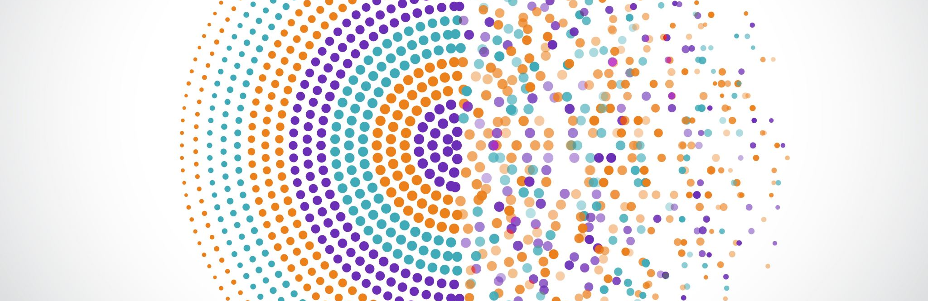
Deep Learning for fMRI motion correction
Preliminary ideas

Slide 2
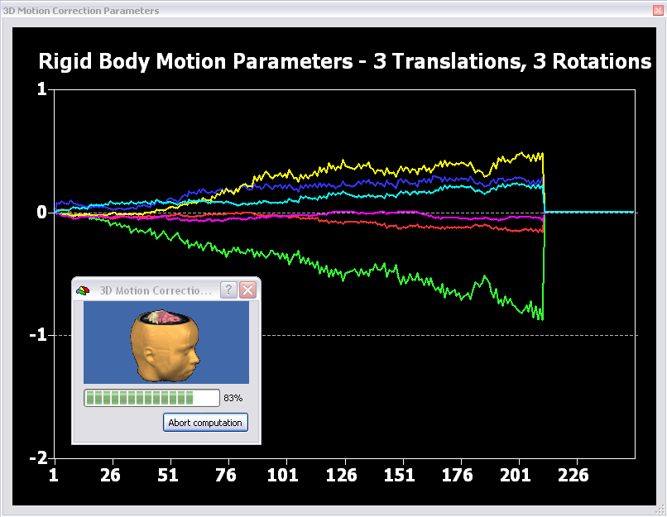
Why Deep Learning
Motion correction of fMRI data is implemented as an optimization procedure based on the Levenberg–Marquardt algorithm.
It aims to rotate and translate a movable volume to reach a good match with a target volume.

Slide 3
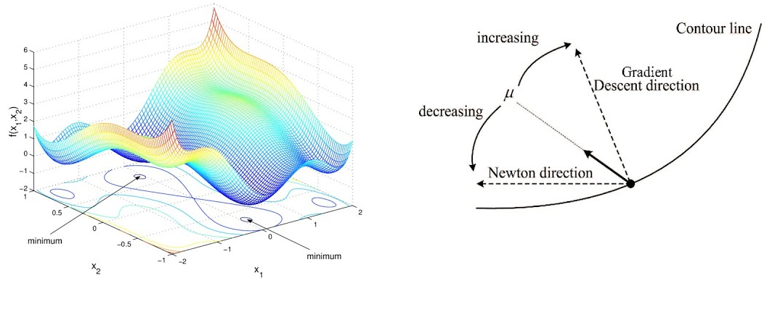
Why Deep Learning
Although it is a relatively simple algorithm it usually deliver good results.
However, sometimes the optimization procedure reaches the maximum number of iterations without reaching a minimum.

Slide 4
A Deep Learning approach would be a good candidate to substitute the optimization approach if:
It delivers more reliable motion correction parameters
It delivers equals or comparable motion correction parameters in less time

Slide 5
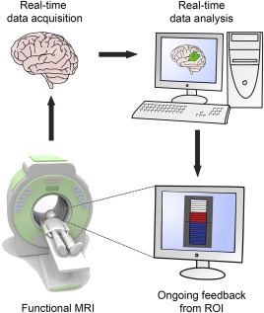
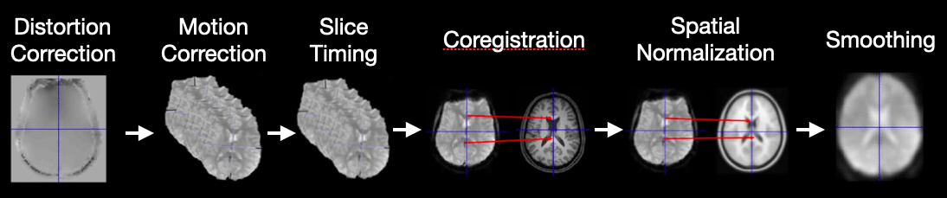
Why Deep Learning
A Deep Learning approach would find important application in
Real-time fMRI
fMRI preprocessing

Slide 6

Existing approaches
Most Deep Learning approaches for MRI images have focused on segmentation and non-linear registration.
An interesting approach is the one presented in Zhao et al. (2020) that at the beginning of its network uses a specific subnetwork for an affine registration.

Slide 7
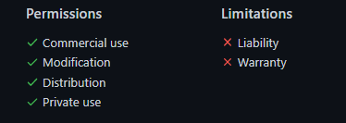
Existing approaches
The code is available at https://github.com/microsoft/Recursive-Cascaded-Networks under MIT license
.

Slide 8
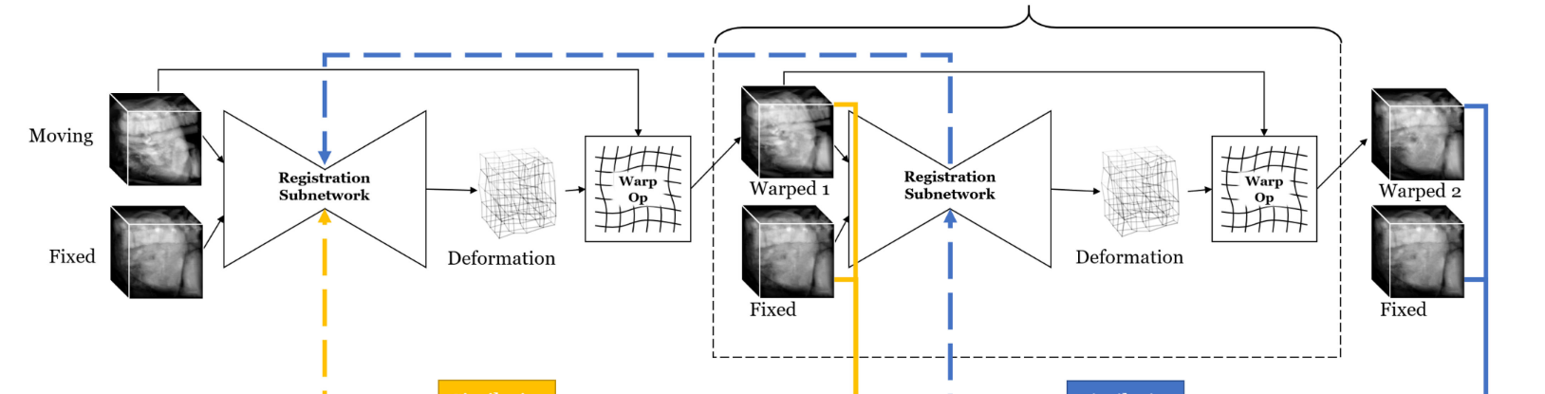
Existing approaches
Zhao et al. proposed a cascade of neural 3D CNN.
Each network aims registering the moving image to the original target image and the final warping is applied using a Spatial Transformer Network (STN) (Jaderberg et al. 2015).

Slide 9
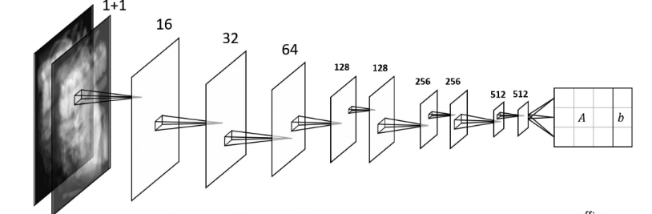
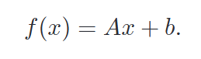
Existing approaches
It consists of a series of 3D convolutional layer applied to the concatenated volumes and a fully connected layer at the end generates 12 parameters:
9 (A matrix) indicating the rotation parameters
3 parameters that forms the displacement vector b
The affine registration network is the first subnetwork applied to the 3D images.

Slide 10
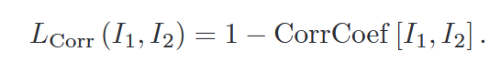
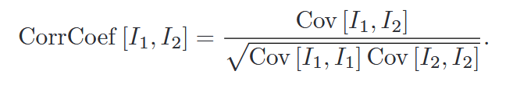
Existing approaches
The LOSS function is based on the correlation coefficient between the estimated transformed image and the fixed image.
CorrCoef is based on the covariance of the images

Slide 11
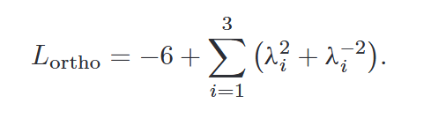
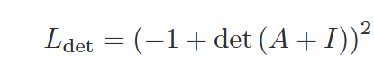
Existing approaches
Two other loss terms are used for the affine registration network. One is based on the orthogonality of the matrix, the other on its determinant.
The orthogonality term ensures that the in the rotation matrix A there will be no shears, thus avoiding overly non-rigid transformation.
The term on the determinant ensures that no transformation involving the reflection of the image is allowed.

Slide 12
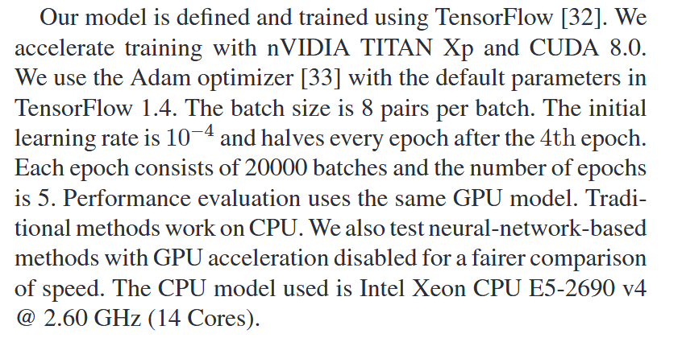
Existing approaches
Zhao et al. used TensorFlow and then compared their output to existing methods such as ANTs.

Slide 13
What can we do?
We could implement only the affine subnetwork and extract both the affine matrix and the registered volumes.
In our case the fixed images would be the first volume of the functional timeseries and the NN would learn to align all the other volumes.
The batch would contain pairs of different subject to improve generalization.
It is a sort of “unsupervised” training as inputs are not labelled. However, the initial volume of the dataset is used as target, therefore as reference for training.

Slide 14
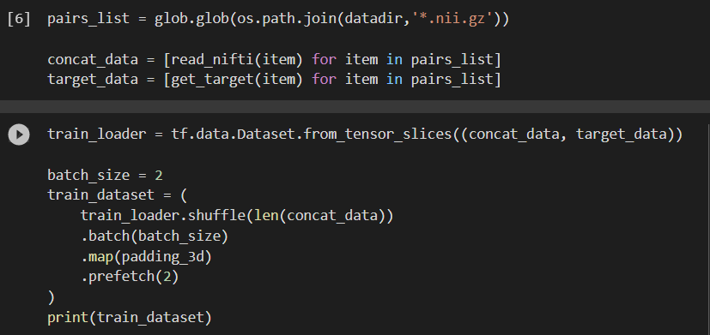
A preliminary implementation
Create the pairs [(target, movable), target]
Before entering the NN, data have been stacked and preprocessed.
For each subject, the functional time series containing N volumes, has been split in N-1 pairs containing the target (volume at instant t=0) and the movable (volume at instant t=i).
Creation of the dataset

Slide 15
A preliminary implementation
Create the pairs [(target, movable), target]
The N-1 pairs “movable-target” are concatenated.
Shis pair are inserted in a tuple with the single target volume.
Then the training dataset with batch size of 8 is created.
Creation of the dataset

Slide 16
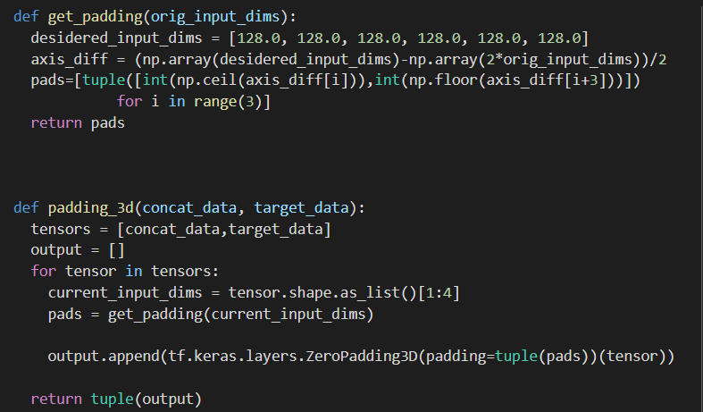
A preliminary implementation
Get how much padding is needed
During the creation of the dataset each tensor is zero-padded in 3D to have a dimension of 128x128x128.
Apply the 3D padding

Slide 17
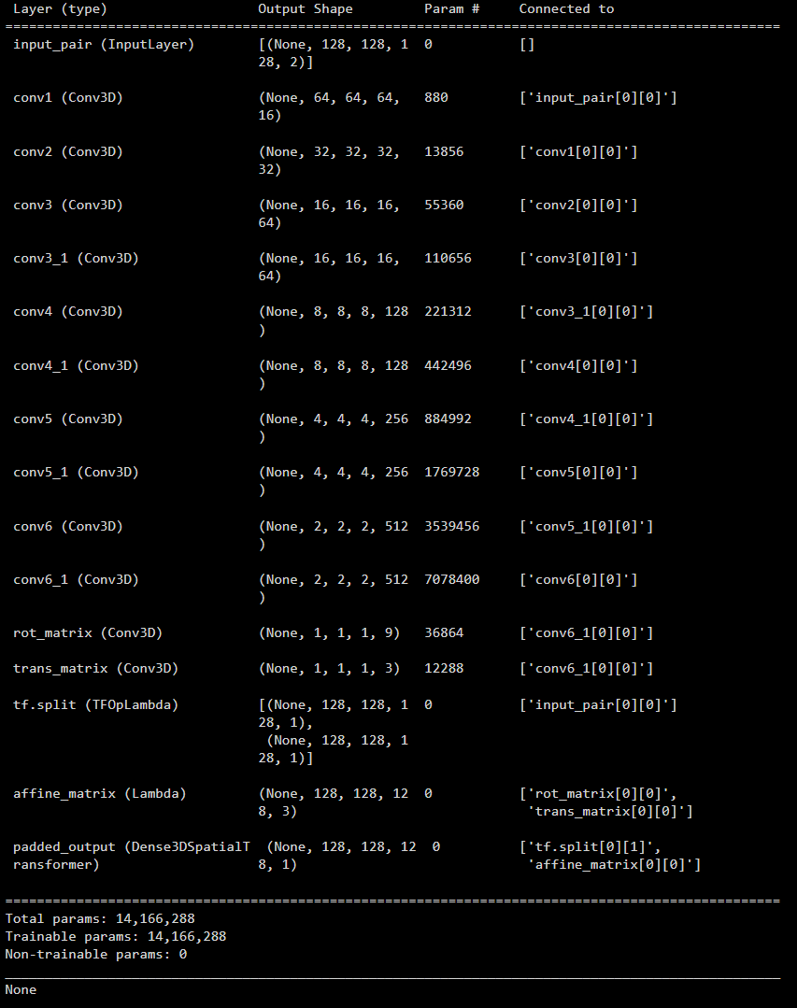
A preliminary implementation
Keras functional API were used to build the NN.
The input of the NN would be a tensor containing the fixed image (the first of the fMRI series) and the movable image (all the other volume of the timeseries) which size would be
(None, 128,128,128,2)
Batch size
X dim
Y dim
Z dim
channels

Slide 18
A preliminary implementation
The two concatenated inputs are given in input to a series of 3D convolutional layers that reduce the resolution and increase the channels as the number of filters is gradually increased.
At the end of this set of convolutional layers the output dimension would be: (1, 2, 2, 2, 512).
Before that the tensor of the movable image is extracted from the input to be used in the last layer.

Slide 19
A preliminary implementation
The output of the last convolutional layer is given in input to two different layers:
rot_matrix: provides 9 parameters that will form the rotation matrix A (dim: 3x3)
trans_matrix: provides 3 parameters that will form the displacement vector b (dim: 1x3)
A
b
a_{i}
a_{i}
a_{i}
b_{i}
a_{i}
a_{i}
a_{i}
b_{i}
a_{i}
a_{i}
a_{i}
b_{i}
0
0
0
1

Slide 20
A preliminary implementation
A
b
a_{i}
a_{i}
a_{i}
b_{i}
a_{i}
a_{i}
a_{i}
b_{i}
Flow field
a_{i}
a_{i}
a_{i}
b_{i}
0
0
0
1
The obtained parameters are provided in input to a custom layer that wrap a function creating a sort of flow field.
The output have the dimension of the images with 3 channels (1, 128, 128, 128, 3).

Slide 21
A preliminary implementation
The affine flow is provided in input to a final custom layer that implement a spatial transformation.
The output of this layer is a transformed image that need to be compared with the fixed image using the loss function.
The code for this transformation has been taken from Balakrishnan et al. (2018).

Slide 22
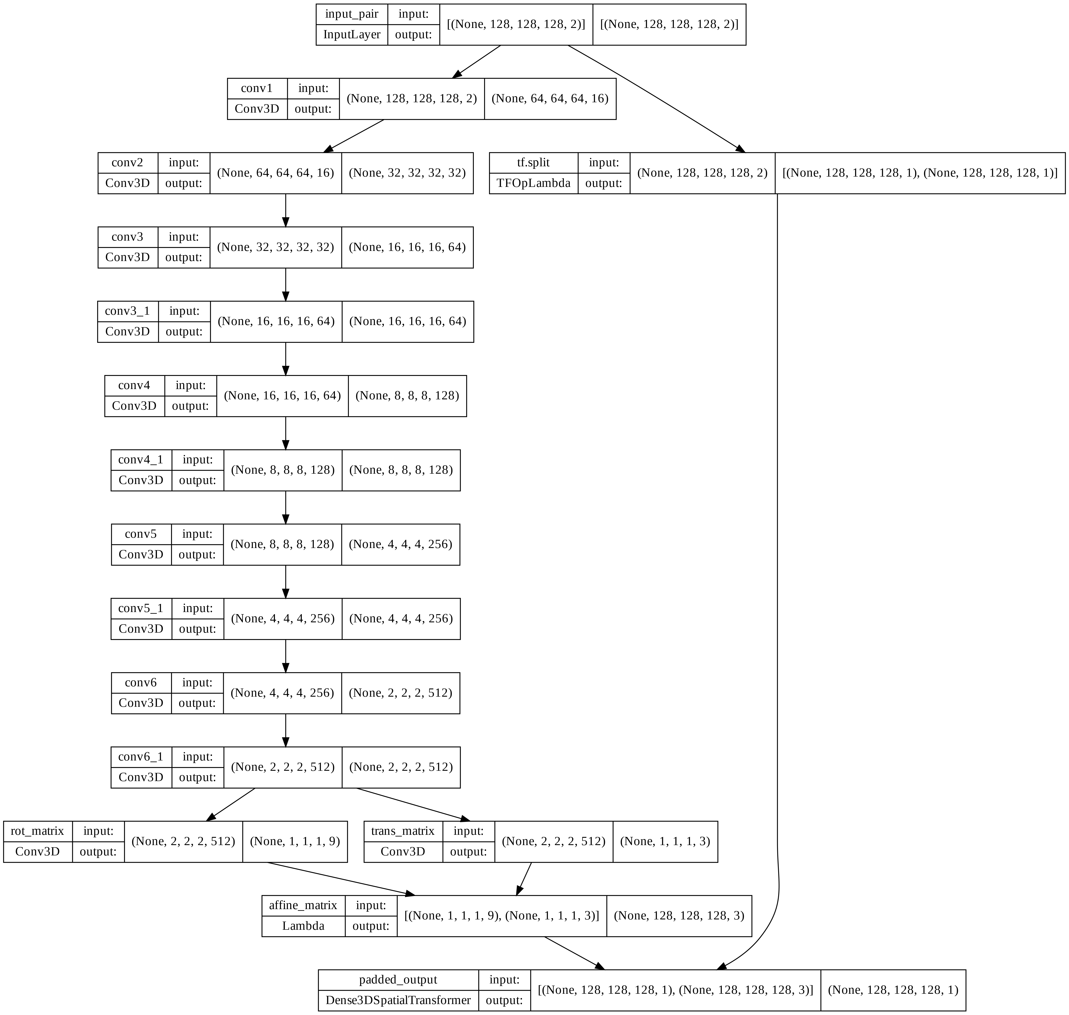
Input pair
movable image

Slide 23
Rotation parameters
Translation parameters

Slide 24
Affine flow

Slide 25
Output 128x128x128

Slide 26
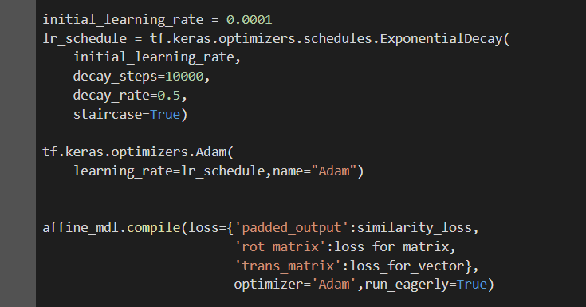
A preliminary implementation
The initial learning rate is set to 10^-4 as suggested by Zhao et al.
Learning rates halve after each epoch following a decreasing exponential trend.
The optimizer is Adam with default params.

Slide 27
A preliminary implementation
Each output is sent to the corresponding loss function:
Similarity loss for the aligned image: based on cross correlation target-image
Loss_for_matrix: to avoid shearing and reflection
Loss_for_vector: fake loss function. It just returns 0

Slide 28
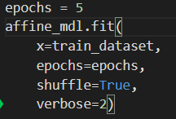
A preliminary implementation
Ha suggested in Zhao et al. we used 5 epochs.
No callbacks were implemented.
The final loss is the sum of the three losses.

Slide 29
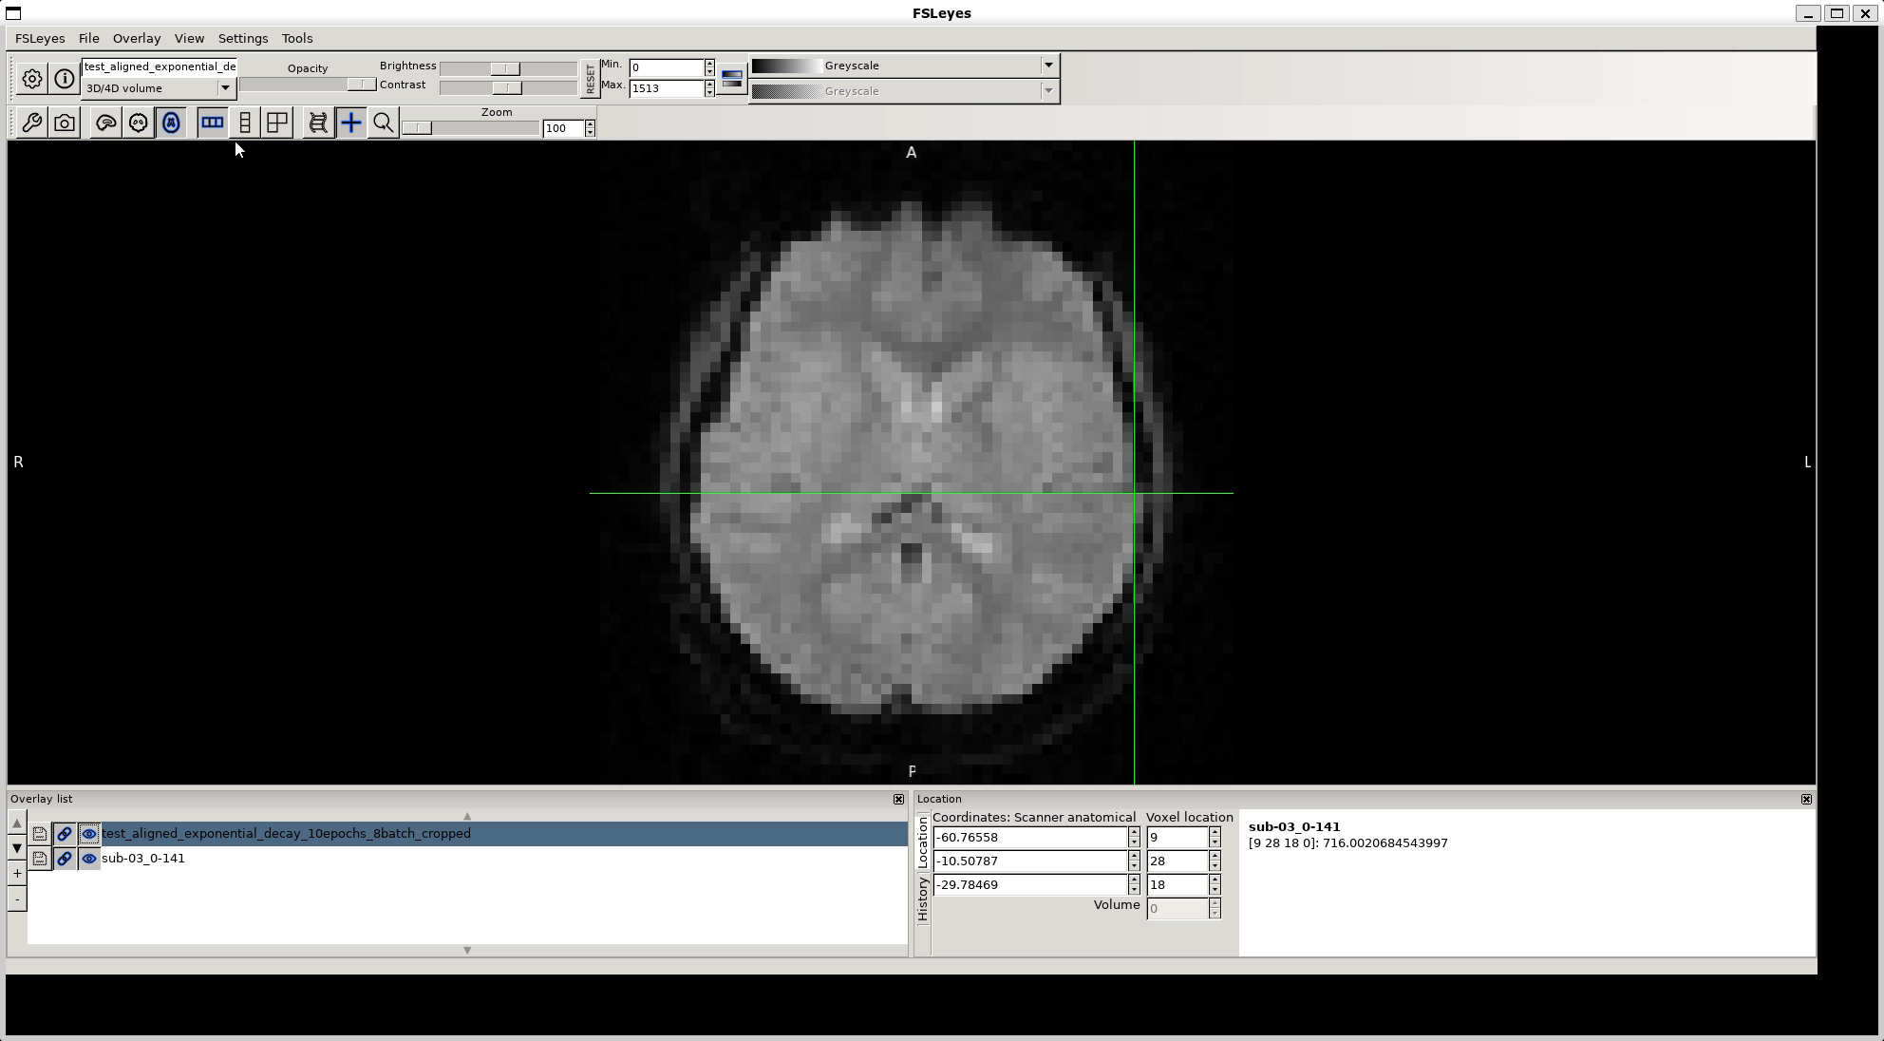
Preliminary results
Training: dataset from one study (435 pairs) Testing: Unseen data from the same study
Aligned data on top of target data

Slide 30
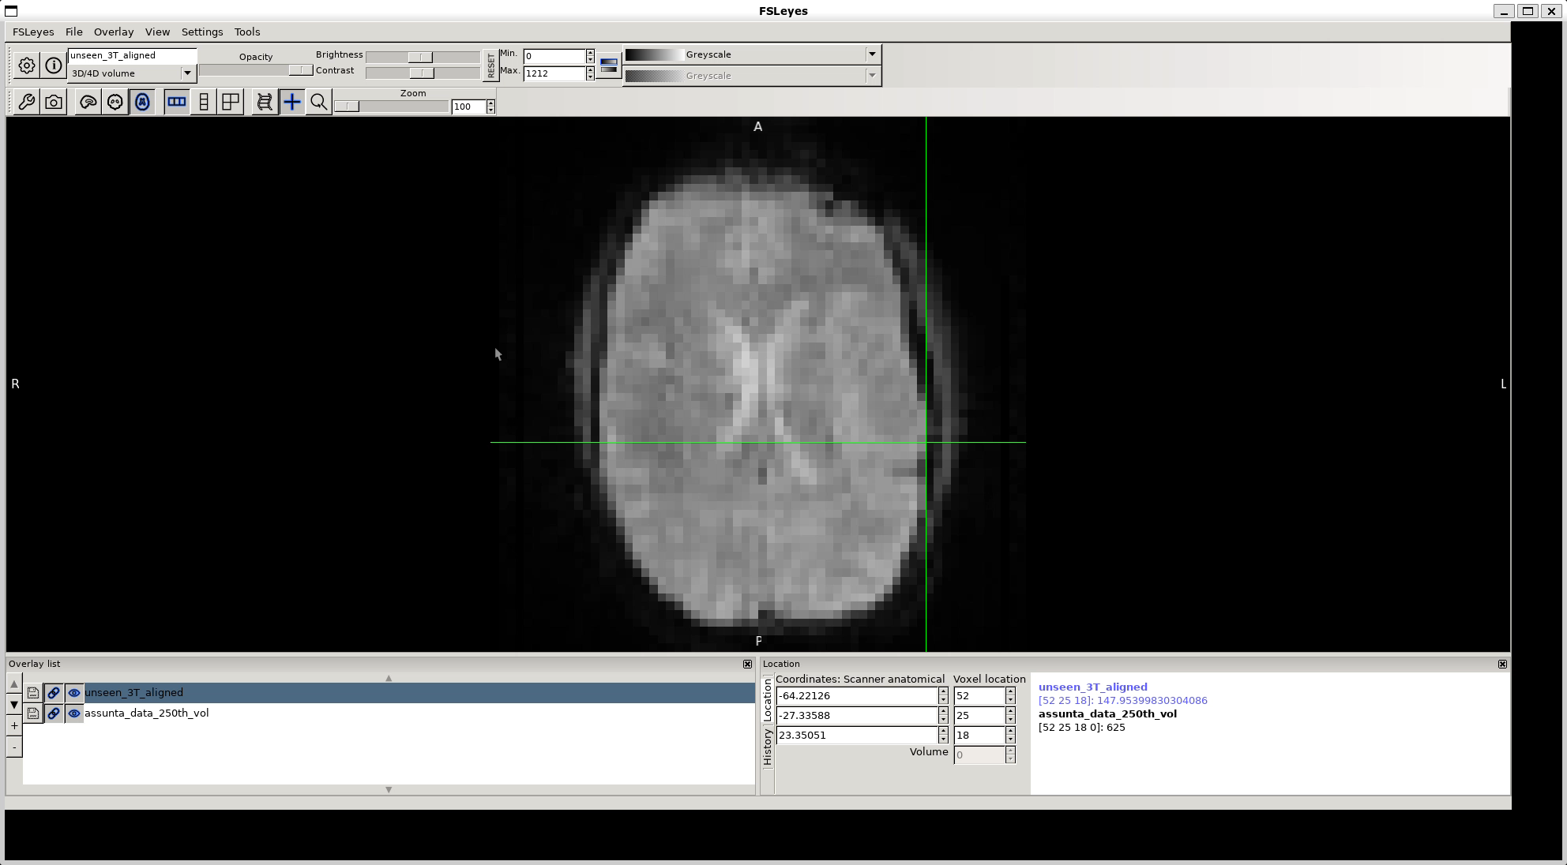
Preliminary results
Training: dataset from one study (435 pairs) Testing: Unseen data from a different study
Aligned data on top of target data

Slide 31
Preliminary results
Clearly training the NN on a dataset and apply it to another dataset did not work
Small movement can be seen also when training and testing dataset have the same origin
It is also possible to observe difference in the intensities of the aligned data, due probably to interpolation function

Slide 32
Next steps
Training with different datasets (different data shapes)
Small preprocessing step on the input data: mask to zero values outside the brain
Check the regularization losses
Explore in greater details the transformation layer: is it possible to use a spline interpolation?

Slide 33
Next steps
Study papers with similar implentations
Explore callbacks
Decide a training strategies: data augmentation? How many different subjects?
Explore validation metrics

